Slide 1
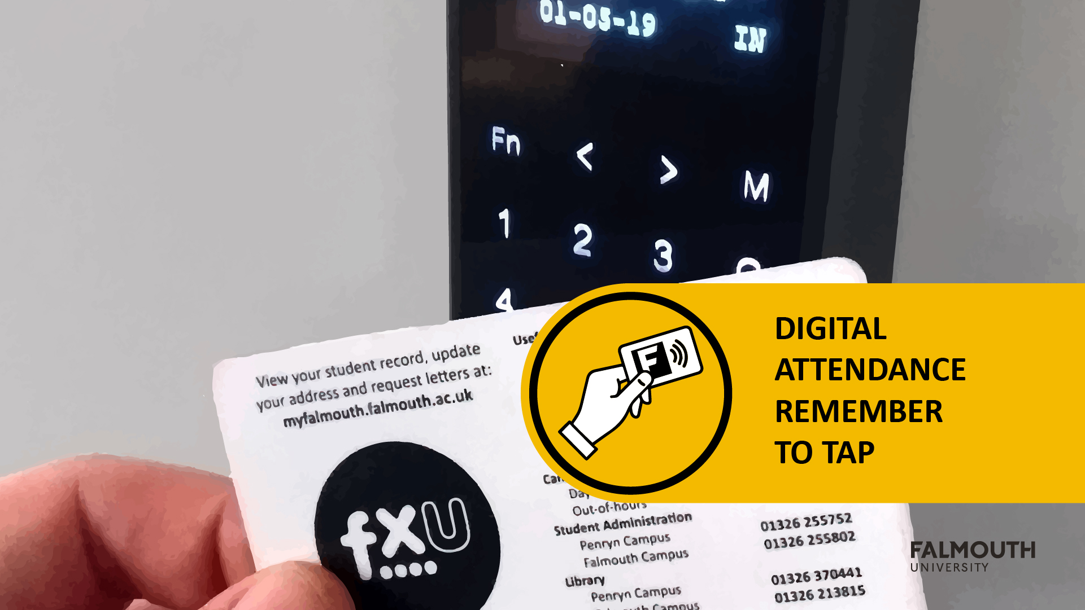

Slide 2



Slide 3
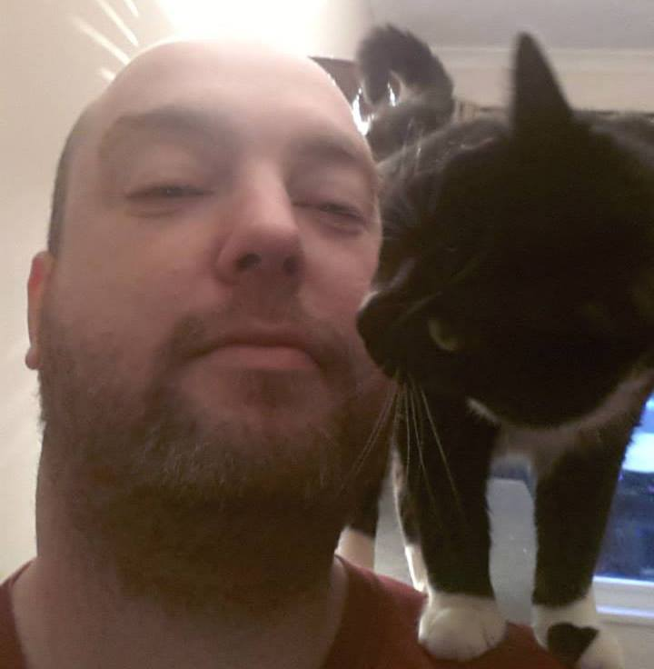
Brian McDonald
- Programming and Development
Brian is a keen advocate for the Games Development Community. He was elected to serve on the board of IGDA Scotland from 2013 - 2016. In this role he helped bring together the Game Developers from around Scotland by organising monthly meetings and developer talks.
brian.mcdonald@falmouth.ac.uk

Slide 4
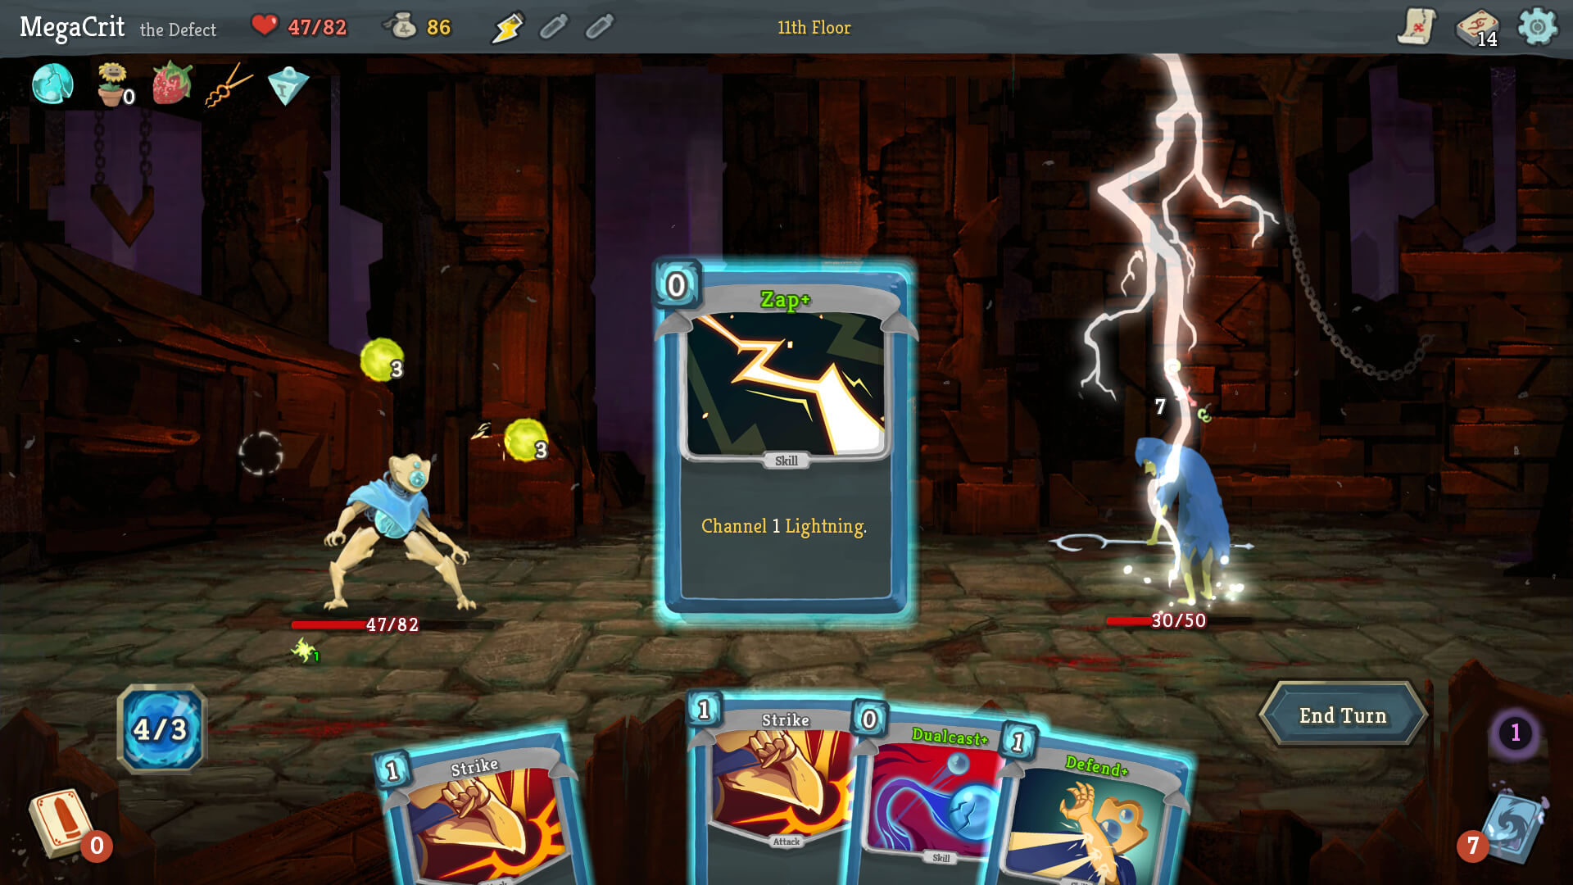

Slide 5
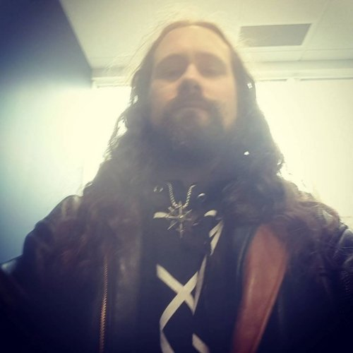
Jeff Howard – Game Design
Dr. Jeff Howard specialises in occult, metal, and Gothic themes and mechanics in games.
His theory and practice converge in his work as lead designer of Arcana, as Chief Creative Officer of ArcanaForge, LLC, and as a worldbuilding consultant for Apocalypse Studios on Deadhaus Sonata. He is the author of Game Magic: A Game Designer’s Guide to Magic Systems in Theory and Practice and Quests: Design, Theory, and History in Games and Narratives
jeff.howard@falmouth.ac.uk

Slide 7

Module
Aims
https://learningspace.falmouth.ac.uk/course/view.php?id=3958
Please check the award maps for more details on this structure

Slide 8
Module AIMS
To deliver an engaging digital product using specialist skills and multidisciplinary collaboration in an industry-standard context.

Slide 9
More Broadly
work in multi-skilled teams to make a proof of concept of a digital product
You gain hands-on experience of the development pipeline and of production in an ‘agile’ context
The course team reinforce iterative methods as they supervise and monitor the work-in-progress
By the end of the module, your team should have a small functional proof of concept.

Slide 10
What is Proof of Concept?
In Game Development, A Proof of concept can be used:
To seek funding
Test out a process or technology
Verify the direction
This means that the Game doesn’t need to be ‘finished’, but there is enough there to get an understanding of what the finished product could be
Remember – the games you play at home are finished. The games you make are work-in-progress. #blocktober

Slide 11
Learning Outcomes
ID | NAME | DESCRIPTION | ASSESSMENT CRITERIA CATEGORY
6 | Reflect | Identify professional attributes and illustrate how they are relevant to your practice. | ANALYSIS
7 | Collaborate | Define the suitable development practices, project management approaches, and version control tools in the execution of a collaborative project. | COLLABORATION
9 | Deliver | Describe how to create and test prototypes in order to deliver an interesting experience. | INNOVATION

Slide 12
Assignments
Please check learning space for full details
https://learningspace.falmouth.ac.uk/course/view.php?id=3958

Slide 13
Assignment
Assignment 1 – Studio Practice – 70%
Assignment 2 – Evaluation – 30%
Check MyFalmouth for Deadlines - https://myfalmouth.falmouth.ac.uk/

Slide 14
Assignment 1 – Studio Practice
Supervisor meetings
Attend the scheduled weekly team meeting with your project supervisor.
There are two types of project meeting:
A project review / planning session - Your team will showcase work undertaken on the most recent sprint and then plan the next sprint
An individual review - You and your teammates will review each other’s approaches to work over the last sprint

Slide 15
Assignment 1 – Studio Practice
Studio Practice
You will work as a team in timetabled sessions
There will be members of staff on hand to lend support
Please ask for specialist support in these sessions
Staff will be assigned to assess your game
Expo
Held during Week 13
More about this soon!

Slide 16
Assignment 1 – marking Rubric

Slide 17
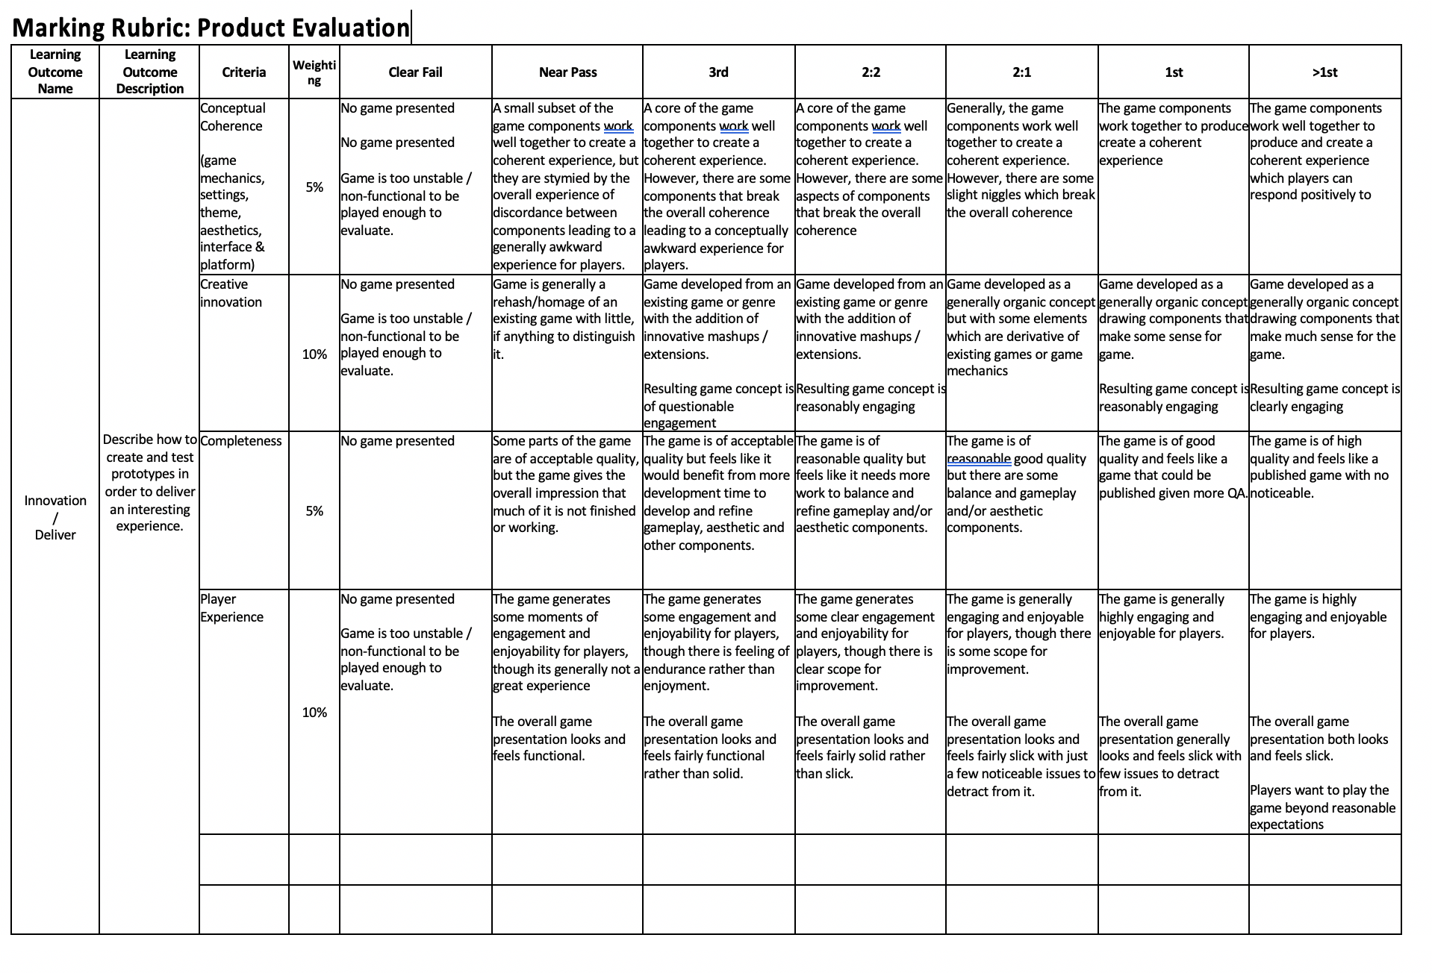
Assignment 1 – marking Rubric

Slide 18
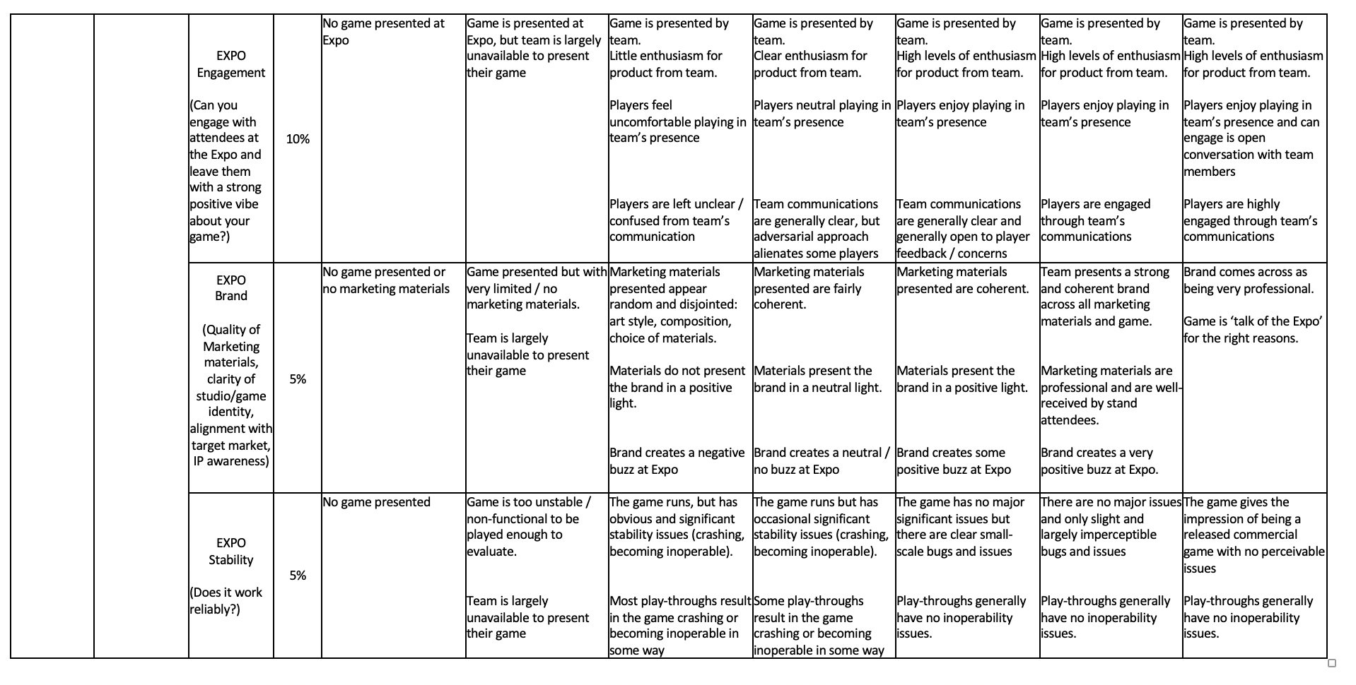
Assignment 1 – marking Rubric

Slide 19
Studio Practice – things to note
Supervisor meetings are assessed and you will be marked on each sprint
You should always turn up with a working build
you can also show off artwork and works in progress
Marks for sprints will be normalised at the end of demo day

Slide 20
Assignment 2 – EVALUATION
you will write a 1500-word evaluation of your work on your game development so far
You will reflect on:
Progress on the development of the game
How it is going
Your contribution to it
Think forward to what you would do differently next year
You should create a list of actions for next year, these should be SMART in nature

Slide 21
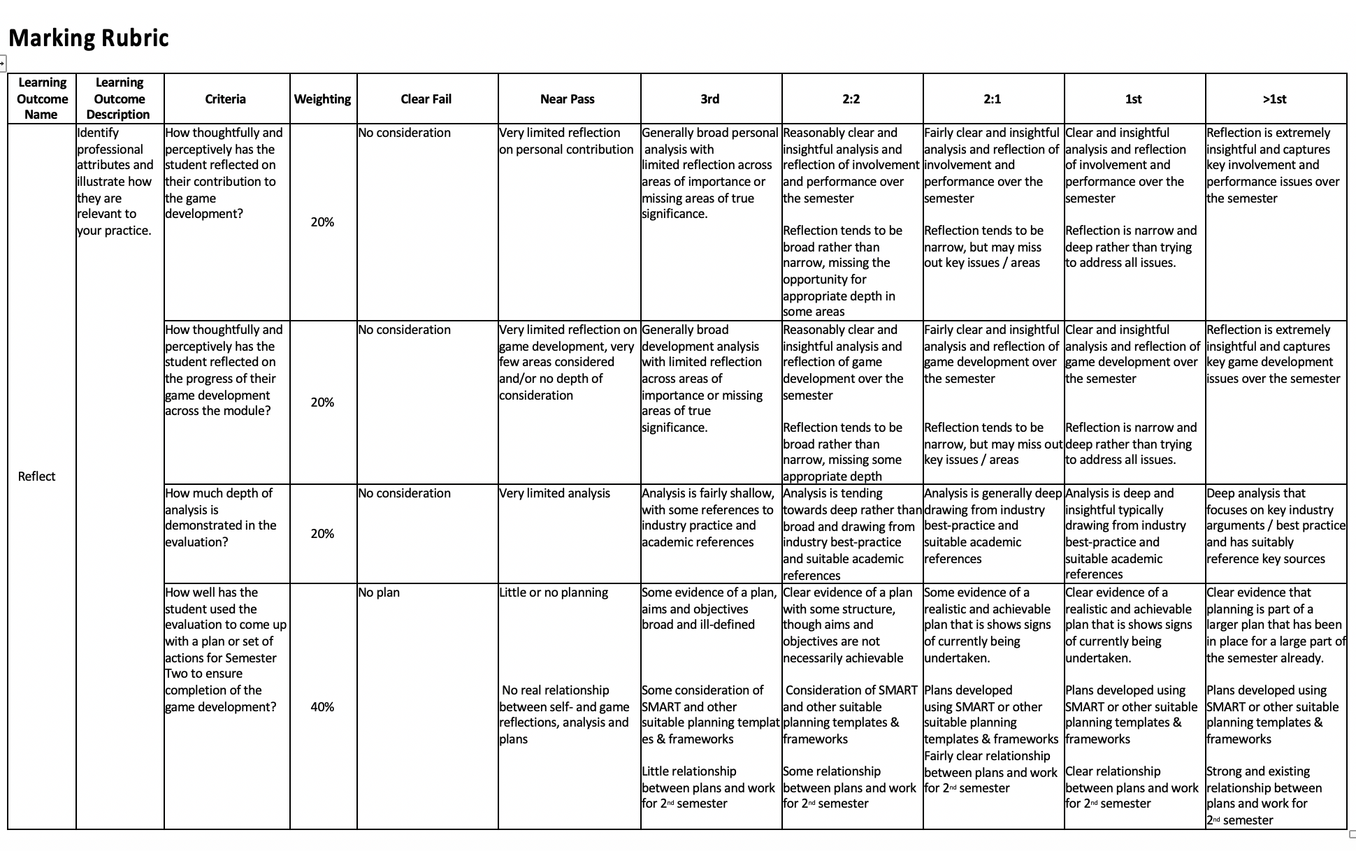
Assignment 2 – Marking Rubric

Slide 22
Assignment 2 – Evaluation
Evaluations are an extremely important part of the learning process and should not be taken lightly:
You must critically appraise both your work and your approach to and understanding of that work.
Do not write a narrative. Pick 3-5 points you consider to be important and explore these in depth critically and reflectively.
As you work on your projects, make a note of interesting points that the evaluation may discuss
Include a plan or set of actions that will help you to complete the development in 2nd year. These should arise from your evaluation

Slide 23
Agile
Practice
https://learningspace.falmouth.ac.uk/mod/resource/view.php?id=50269
Check out the Agile guide for more details

Slide 24
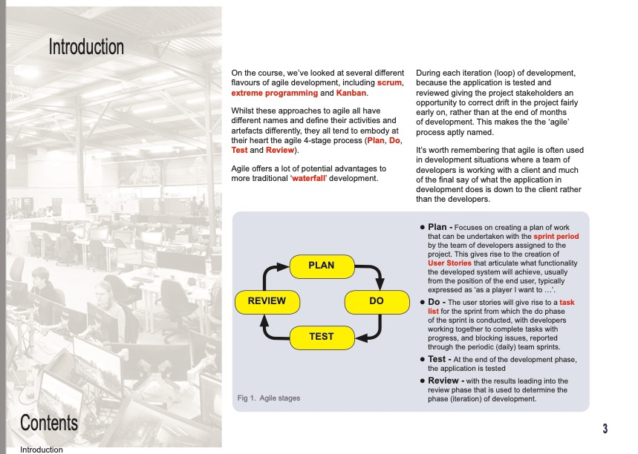
AGILE guide

Slide 25
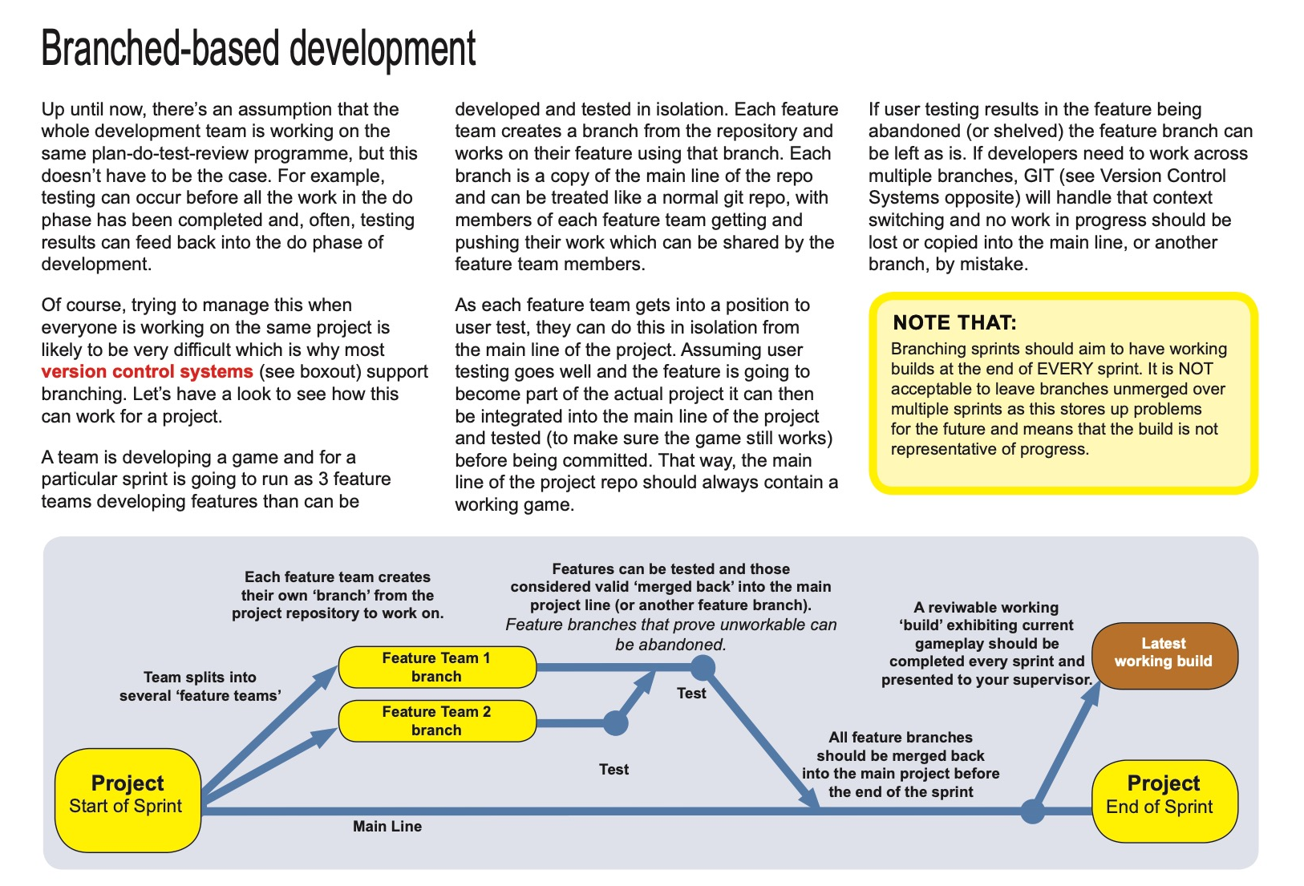
AGILE guide

Slide 26
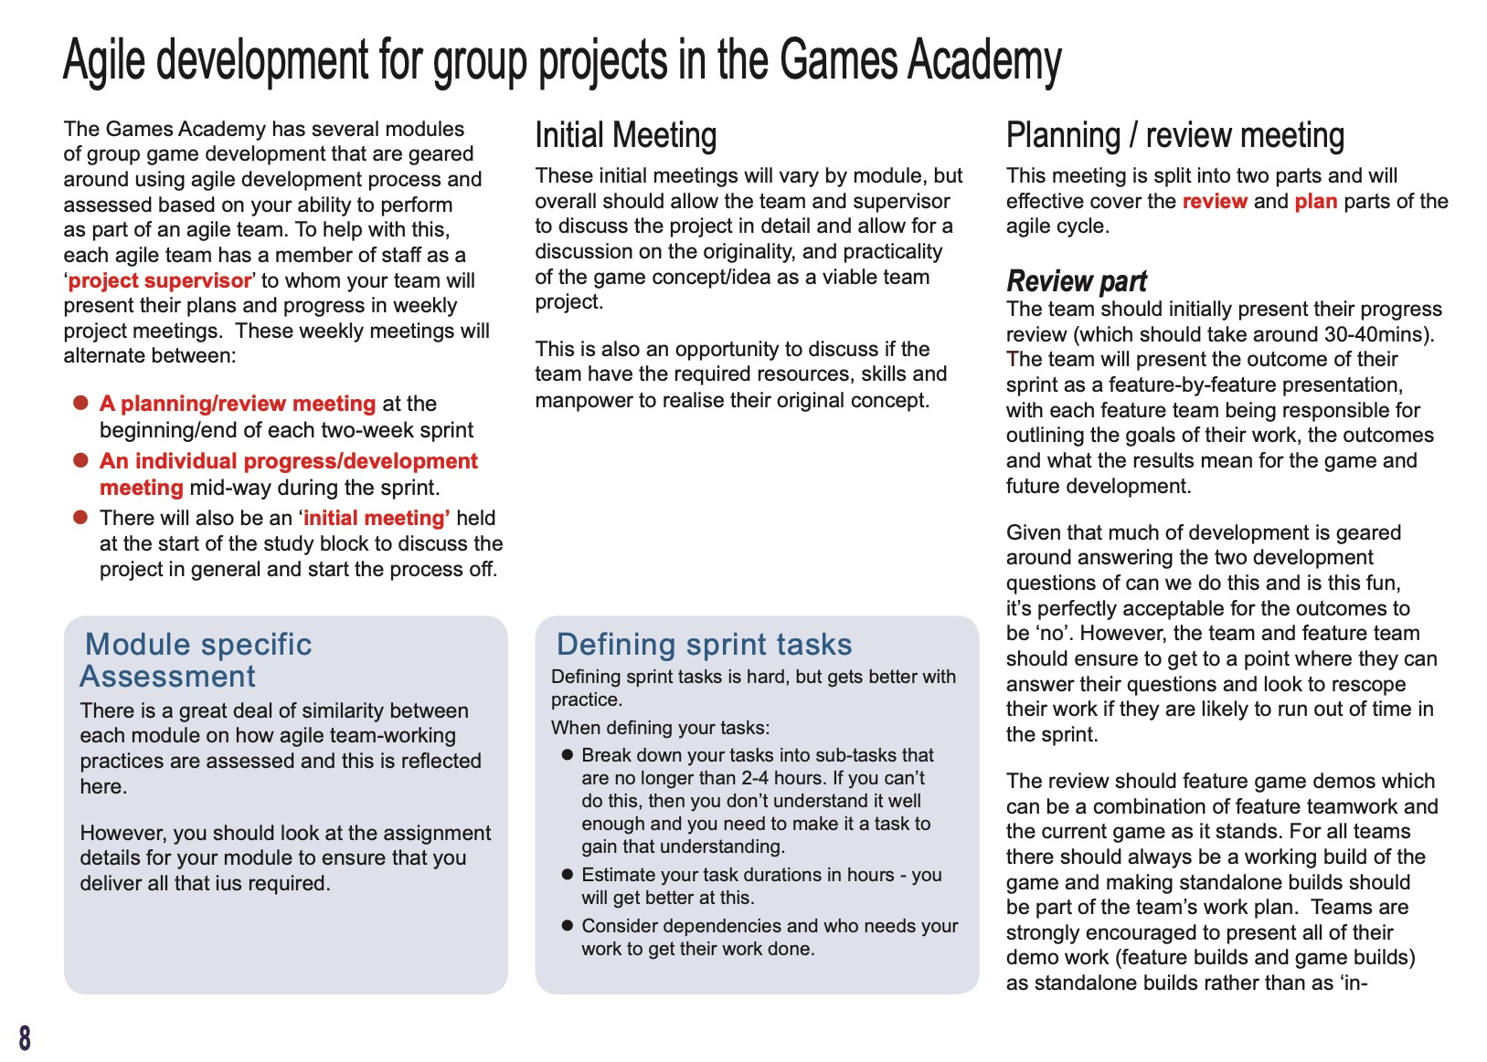
AGILE guide

Slide 27
Studio Culture

Slide 28
Studio Culture
At the games academy we do not tolerate harassment or bullying
We also adhere to the student code of conduct
https://www.falmouth.ac.uk/student-regulations
If there is any issues at all. please speak to a supervisor, module leader or personal tutor
Please be a supportive team member!

Slide 29
Questions?

